Slide 1
Finding Your Best Friend
Happy Tails
Alejandro, Cathy, Kyndall, and Sun

Slide 2

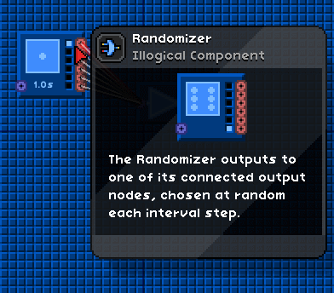
The Mission
Create a relational database of adopted and adoptable pets using the PetFinder API.
Use Leaflet to visualize adoptable and adopted pet trends.
Create a website that hosts pet data, pet visualizations, and a randomizer tool to select a pet for you (according to your zip code, breed preference, or size preference)

Slide 3
Success Stories
✓
Extracting the data from the PetFinder API and creating subcategories to filter the data based on aspects like breed, type, and zip-code.
Created a relational database in SQL and loaded the data into Flask API.
Created a homepage and individual html pages to host different functions.
Created an interactive leaflet map visualization.
Coded javascript files for data visualizations and the randomizer.
Created multiple css style sheets to format html pages.
✓
✓
✓
✓
✓

Slide 4
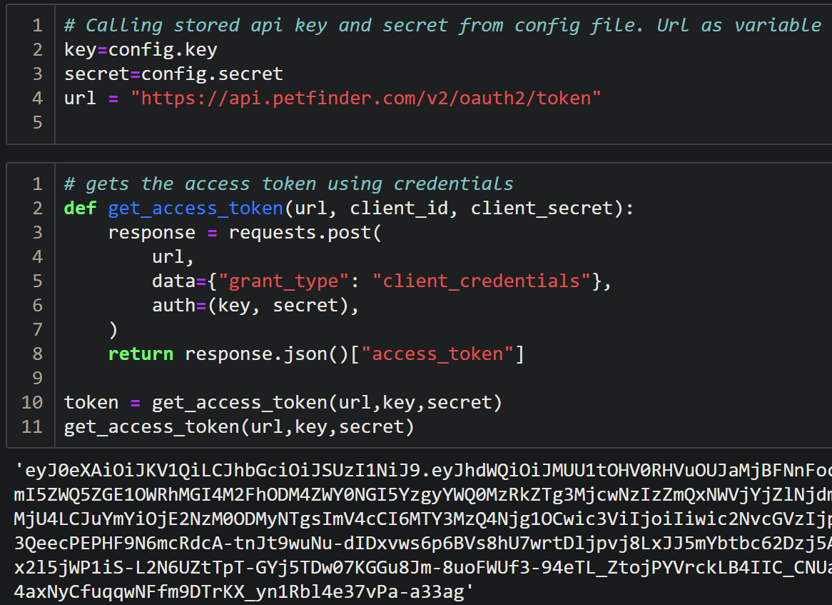
PetFinder API Data Extraction
Creating a successful api connection to PetFinder
Notes:
Sun: For the petfinder data extraction we needed to make a connection to the api using the developer tools from Petfinder. We were give an API key and secret in order to create a token. Upon successful connection, we were then able to extract data from the api

Slide 5
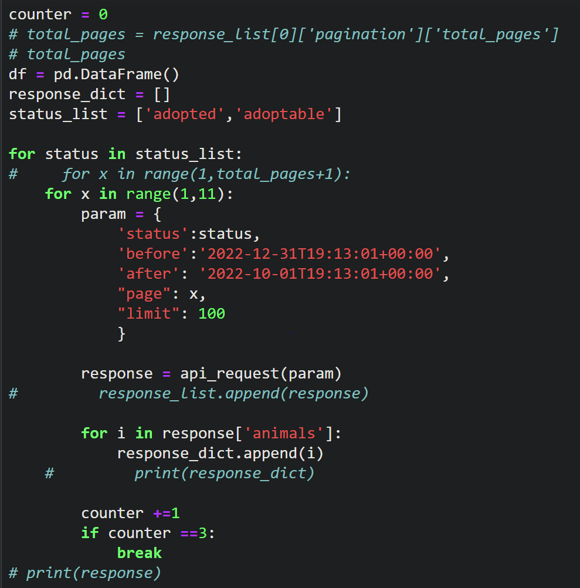
PetFinder API Data Extraction pt 2
Extract data from the PetFinder API based on criteria for data visualizations.
Map Visualization dataset and randomizer dataset
Notes:
Sun: In order to get the data into a usable format we created a loop to run through parameters we wanted to specify in the API. We extracted and manipulated the data in python before stowing in a database.

Slide 6
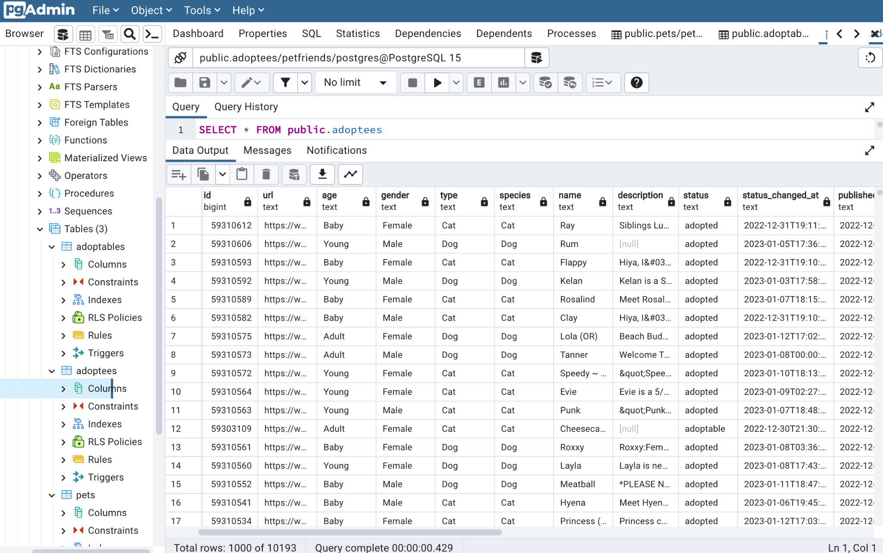
SQL Database Connection
Created a relational database in SQL.
Referenced SQL database to code JS randomizer.
Notes:
Sun: After we completed the ETL process in python, we initialized a connection from python to PGadmin to store our data into a database.

Slide 7
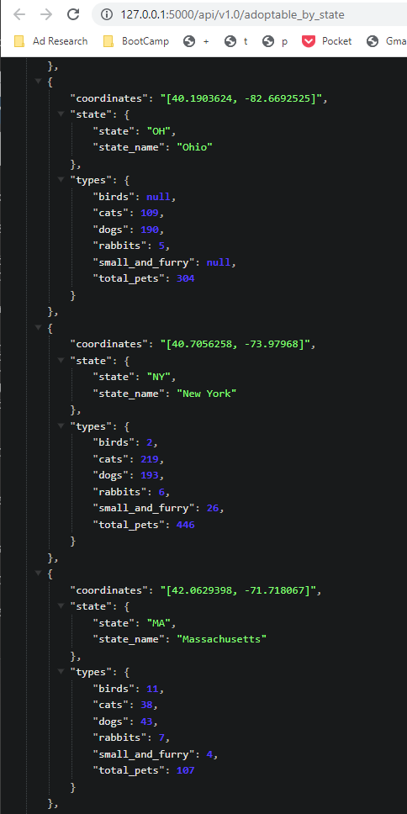
Flask API
Created a Python Flask API to deliver the data to the webpage
Notes:
Sun: After our connection to the database was successful, we implemented flask to create an api route that connects to our PGadmin database and would ultimately host our web route with our intended visualizations

Slide 8
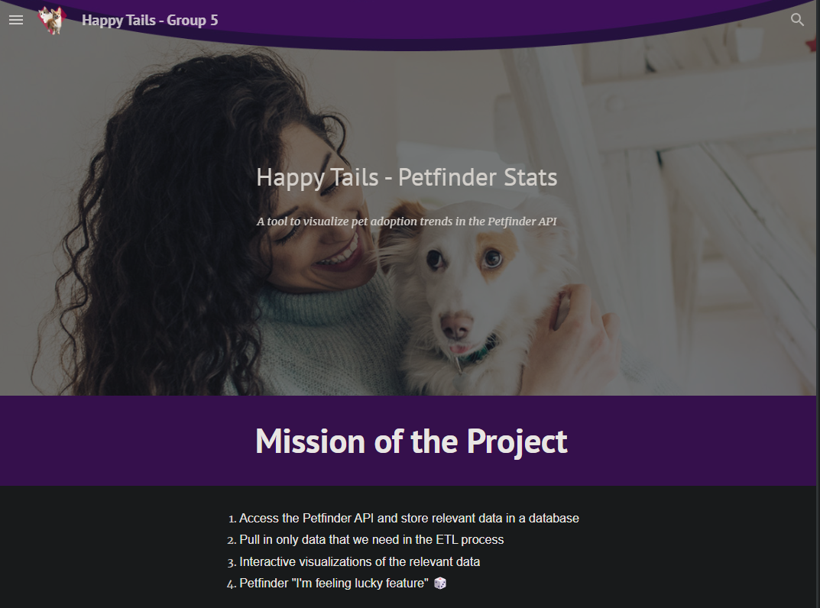
HTML Website
Created a homepage.

Slide 9
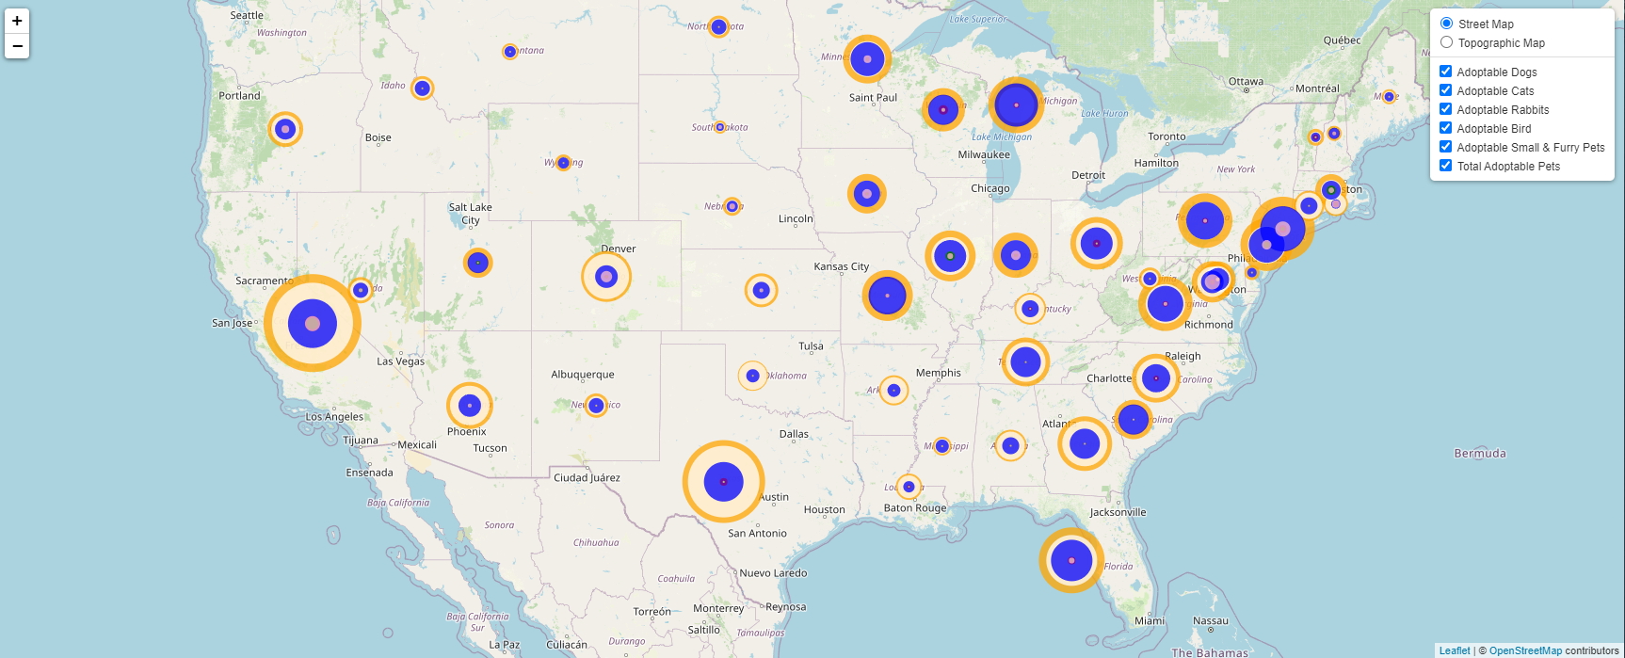
Interactive Leaflet Visualization

Slide 10
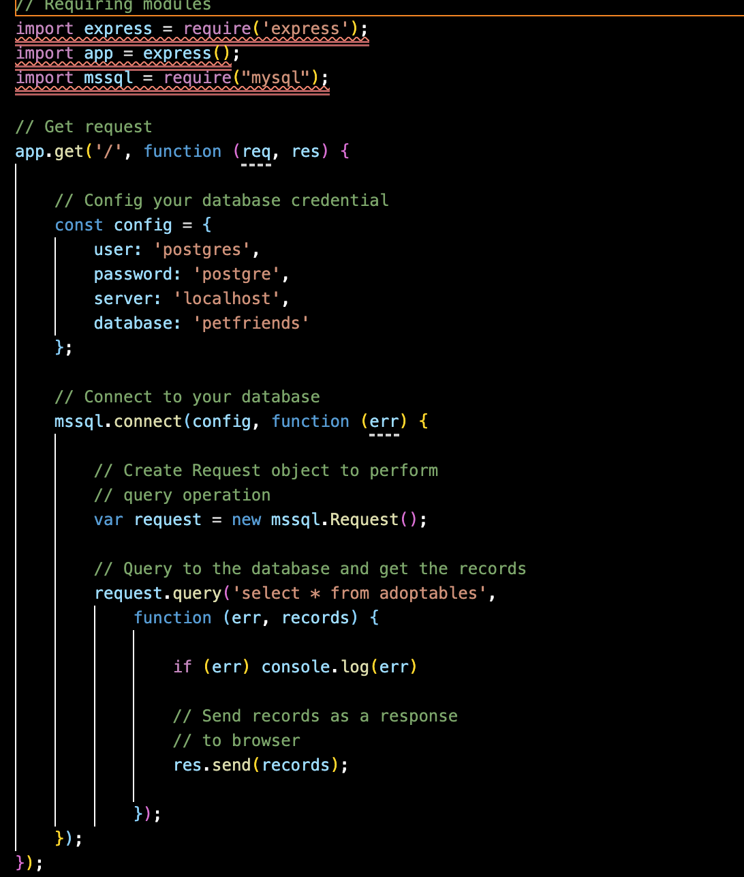
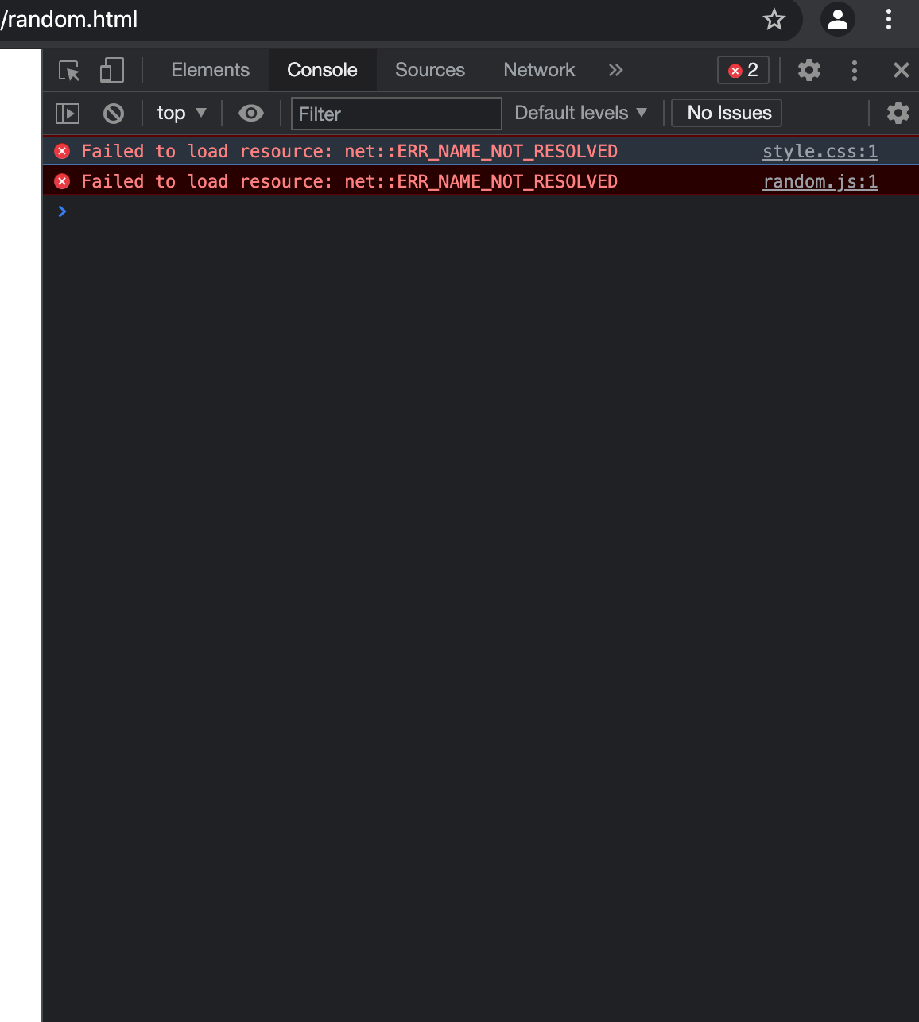
Challenge: Implementing Randomizer
Unable to resolve reference error for randomizer code.

Slide 11
Challenge: Hosting Visualization on Website
Visualization pulls data correctly from Flask API, but is not connected to the Homepage
Notes:
Connected data to JS via app.py

